Slide 1
Dimensionality Reduction Chapter 3 (Duda et al.) – Section 3.8

Slide 2
Curse of Dimensionality
Increasing the number of features will not always improve classification accuracy.
In practice, the inclusion of more features might actually lead to worse performance.
The number of training examples required increases exponentially with dimensionality d (i.e., k^{d}).
3¹ bins
3² bins
k: number of bins per feature
3³ bins

Slide 3
Dimensionality Reduction
What is the objective?
Choose an optimum set of features of lower dimensionality to improve classification accuracy.

Slide 4
Dimensionality Reduction (cont’d)
Feature extraction: finds a set of new features (i.e., through some mapping f()) from the existing features.
Feature selection: chooses a subset of the original features.
The mapping f() could be linear or non-linear
K<<N
K<<N

Slide 5
Feature Extraction
Linear combinations are particularly attractive because they are simpler to compute and analytically tractable.
Given x ϵ R^{N}, find an N x K matrix U such that:
y = U^{T}x ϵ R^{K} where K<N
This is a projection from the N-dimensional space to a K-dimensional space.
U^{T}

Slide 6
Feature Extraction (cont’d)
From a mathematical point of view, finding an optimum mapping y=𝑓(x) is equivalent to optimizing an objective function.
Different methods use different objective functions, e.g.,
Information Loss: The goal is to represent the data as accurately as possible (i.e., no loss of information) in the lower-dimensional space.
Discriminatory Information: The goal is to enhance the class-discriminatory information in the lower-dimensional space.

Slide 7
Feature Extraction (cont’d)
Commonly used linear feature extraction methods:
Principal Components Analysis (PCA): Seeks a projection that preserves as much information in the data as possible.
Linear Discriminant Analysis (LDA): Seeks a projection that best discriminates the data.
Some other interesting methods:
Retaining interesting directions (Projection Pursuit),
Making features as independent as possible (Independent Component Analysis or ICA),
Embedding to lower dimensional manifolds (Isomap, Locally Linear Embedding or LLE).

Slide 8
Principal Component Analysis (PCA)
Let’s represent x∈R^{N} as a linear combination of an orthonormal set of N basis vectors <v₁,v₂,…,v_{𝑁}> in R^{N} :
PCA seeks to represent x in a new space of lower dimensionality using only K basis vectors (K < N)
such that is minimized
(i.e., minimize information loss)

Slide 9
Principal Component Analysis (PCA)
How should we determine the “optimal” lower dimensional space basis vectors <u₁, u₂, …,u_{K}> ?
The optimal space of lower dimensionality can be defined by:
(1) Finding the eigenvectors u_{𝑖} of the covariance matrix of the data Σ_{x}
Σ_{x} u_{𝑖}= 𝜆_{𝑖} u_{𝑖}
(2) Choosing the K “largest” eigenvectors u_{𝑖} (i.e., corresponding to the K “largest” eigenvalues 𝜆_{𝑖})
We refer to “largest” eigenvectors u_{𝑖} as principal components.

Slide 10
PCA - Steps
Suppose we are given x₁, x₂, ..., x_{M} N x 1 vectors
Step 1: compute sample mean
Step 2: subtract sample mean (i.e., center data at zero)
Step 3: compute the sample covariance matrix Σ_{x}
where A=[Φ₁ Φ₂ ... Φ_{Μ}]
(N x M matrix)

Slide 11
PCA - Steps
Step 4: compute the eigenvalues/eigenvectors of Σ_{x}
Since Σ_{x} is symmetric, <u₁,u₂,…,u_{N}> form an orthogonal basis in R^{N}, therefore:
are the corresponding
eigenvectors
we assume
Note : most software packages return the eigenvalues (and corresponding eigenvectors)
is decreasing order – if not, you need to do it yourself)
Note : most software packages normalize u_{i} to unit length to simplify calculations; if not, you need to do it yourself):

Slide 12
PCA - Steps
Step 5: dimensionality reduction step – approximate x using only the first K eigenvectors (K<N) (i.e., corresponding to the K largest eigenvalues where K is a parameter):
approximate using first K terms
or
i.e., the columns of U are the
the first K eigenvectors of Σ_{x}

Slide 13
PCA – Linear Transformation
The linear transformation R^{N} → R^{K} which performs the dimensionality reduction is:
y = U^{T}x ϵ R^{K} where K<N
i.e., the rows of U^{T} are the
the first K eigenvectors of Σ_{x}

Slide 14
Example
Compute the PCA for dataset
(1,2),(3,3),(3,5),(5,4),(5,6),(6,5),(8,7),(9,8)
Compute the sample covariance matrix is:
The eigenvalues can be computed by finding the roots of the characteristic polynomial:

Slide 15
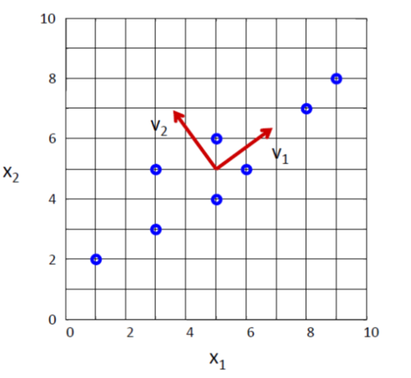
Example (cont’d)
The eigenvectors are the solutions of the systems:
Normalize the eigenvectors vectors to unit-length.
Note: if u_{i} is a solution, then (cu_{i}) is also a solution where c is any constant.

Slide 16
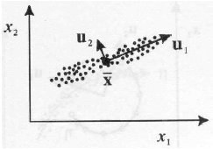
Geometric interpretation of PCA
PCA chooses the eigenvectors of the covariance matrix corresponding to the largest eigenvalues.
The eigenvalues correspond to the variance of the data along the eigenvector directions.
Therefore, PCA projects the data along the directions where the data varies most.
u₁: direction of max variance
u₂: orthogonal to u₁

Slide 17
How do we choose K ?
K is typically chosen based on how much information (variance) we want to preserve:
If T=0.9, for example, we say that we “preserve” 90% of the information (variance) in the data.
If K=N, then we “preserve” 100% of the information in the data (i.e., just a change of basis)

Slide 18
Approximation Error
The approximation error (or reconstruction error) can be computed as:
It can also be shown that the approximation error can be computed as follows:
where
(reconstruction)

Slide 19
Data Normalization
The principal components are dependent on the units used to measure the original variables as well as on the range of values they assume.
Data should always be normalized prior to using PCA.
A common normalization method is to transform all the data to have zero mean and unit standard deviation:
where μ and σ are the mean and standard
deviation of the i-th feature x_{i}

Slide 20
Comments
PCA simply performs a coordinate rotation that aligns the transformed axes with the directions of maximum variance.
The new covariance matrix Σ_{y} is diagonal (i.e., PCA simply de-correlates the variables).
Note that if the data follow a Gaussian distribution, then the variables also become independent.
The main limitation of PCA is that it does not consider class separability since it does not take into account the class information.
i.e., there is no guarantee that the directions of maximum variance will contain good features for discrimination.

Slide 21
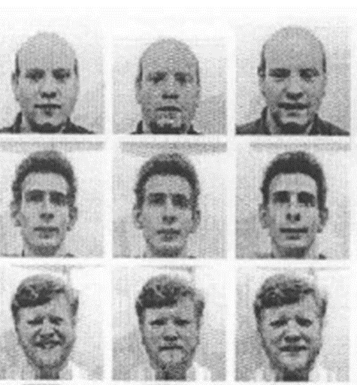
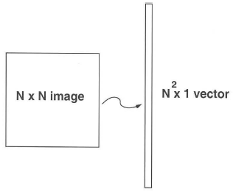
Application to Images – Practical Issues
The goal is to represent images in a space of lower dimensionality using PCA.
Useful for various applications, e.g., face recognition, image compression, etc.
Given M images of size N x N, first represent each image as a 1D vector (i.e., by stacking the rows together).
Note that for face recognition, faces must be centered and of the same size.

Slide 22
Application to Images (cont’d)
The key challenge is that the covariance matrix Σ_{x} is now very large (i.e., N² x N²) – see Step 3:
Step 3: compute the covariance matrix Σ_{x}
Σ_{x} is now an N² x N² matrix – computationally expensive to compute its eigenvalues/eigenvectors λ_{i}, u_{i}
(AA^{T})u_{i}= λ_{i}u_{i}
where A=[Φ₁ Φ₂ ... Φ_{Μ}] (N² x M matrix)

Slide 23
Application to Images (cont’d)
We will use a simple “trick” to get around this!
Let us consider the matrix A^{T}A instead (i.e., M x M matrix)
Suppose its eigenvalues/eigenvectors are μ_{i}, v_{i}
(A^{T}A)v_{i}= μ_{i}v_{i}
Multiply both sides by A:
A(A^{T}A)v_{i}=Aμ_{i}v_{i} or (AA^{T})(Av_{i})= μ_{i}(Av_{i})
Since (AA^{T})u_{i}= λ_{i}u_{i}
λ_{i}=μ_{i} and u_{i}=Av_{i}
A=[Φ₁ Φ₂ ... Φ_{Μ}] (N² x M matrix)

Slide 24
Application to Images (cont’d)
But do AA^{T} and A^{T}A have the same number of eigenvalues/eigenvectors?
AA^{T} can have up to N² eigenvalues/eigenvectors.
A^{T}A can have up to M eigenvalues/eigenvectors.
It can be shown that the M eigenvalues/eigenvectors of A^{T}A are also the M largest eigenvalues/eigenvectors of AA^{T}
Steps 3-5 of PCA need to be updated as follows:

Slide 25
Application to Images (cont’d)
Step 3 compute A^{T}A (i.e., instead of AA^{T})
Step 4: compute μ_{i}, v_{i} of A^{T}A
Step 4b: compute λ_{i}, u_{i} of AA^{T} using λ_{i}=μ_{i} and u_{i}=Av_{i}, then normalize u_{i} to unit length.
Step 5: dimensionality reduction step – approximate x using only the first K eigenvectors (K<M):
each image can be
represented by
a K-dimensional
vector

Slide 26
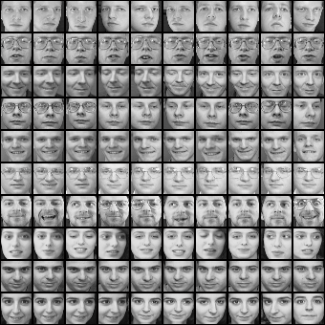
Example
Dataset
Notes:
26

Slide 27
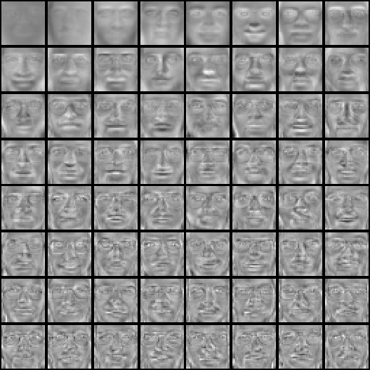

Example (cont’d)
Top eigenvectors: u₁,…u_{k}
(visualized as images - eigenfaces)
u₁
u₂
u₃
Mean face:
Notes:
27

Slide 28
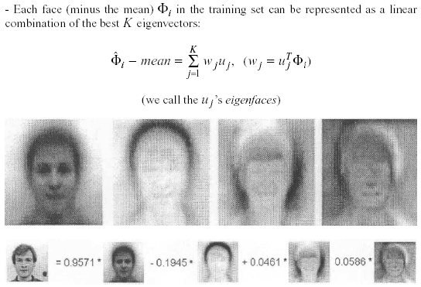
Application to Images (cont’d)
Interpretation: represent a face in terms of eigenfaces
u₁
u₂
u₃
y₁
y₂
y₃

Slide 29
Case Study: Eigenfaces for Face Detection/Recognition
M. Turk, A. Pentland, "Eigenfaces for Recognition", Journal of Cognitive Neuroscience, vol. 3, no. 1, pp. 71-86, 1991.
Face Recognition
The simplest approach is to think of it as a template matching problem.
Problems arise when performing recognition in a high-dimensional space.
Use dimensionality reduction!

Slide 30
Face Recognition Using Eigenfaces
Process the image database (set of images with labels)
Compute PCA space using image database (i.e., training data)
Represent each image in the database with K coefficients Ω_{i}
Given an unknown face Γ, follow these steps:
Ω_{i}

Slide 31
Face Recognition Using Eigenfaces
Step 1: Subtract mean face Ψ (from training)
Φ=Γ-Ψ
Step 2: Project unknown face in the eigenspace:
Step 3: Find closest match to Ω from training set:
Step 4: If e_{r}<T_{r}, then Φ is assigned to person Φ_{i}
The distance e_{r} is called distance in face space (difs)

Slide 32


Face detection vs recognition
Detection
Recognition
“Sally”
Notes:
32

Slide 33
Face Detection Using Eigenfaces
Given an unknown image Γ, follow these steps:
Step 1: Subtract mean face Ψ (from training): Φ=Γ-Ψ
Step 2: Project unknown face in eigenspace:
Step 3: Compute (different from face recognition!)
Step 4: if e_{d}<T_{d}, then Γ is a face
The distance e_{d} is called distance from face space (dffs)

Slide 34
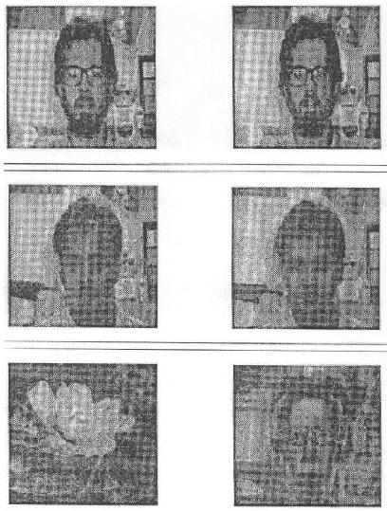
Eigenfaces
Input Reconstructed
Reconstructed image looks
like a face.
Reconstructed image looks
like a face.
Reconstructed image
looks like a face again!

Slide 35

Reconstruction using partial information
Robust to partial face occlusion.
Input Reconstructed

Slide 36
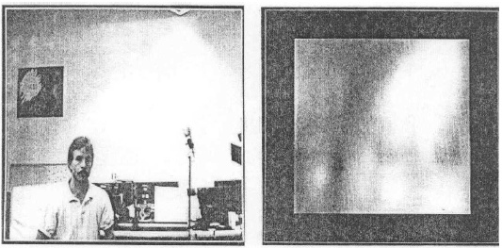
Eigenfaces
Face detection, tracking, and recognition
Visualize dffs as an image:
Dark: small distance
Bright: large distance

Slide 37

Limitations
Background changes cause problems
De-emphasize the outside of the face (e.g., by multiplying the input image by a 2D Gaussian window centered on the face).
Light changes degrade performance
Light normalization might help but this is a challenging issue.
Performance decreases quickly with changes to face size
Scale input image to multiple sizes.
Multi-scale eigenspaces.
Performance decreases with changes to face orientation (but not as fast as with scale changes)
Out-of-plane rotations are more difficult to handle.
Multi-orientation eigenspaces.

Slide 38


Limitations (cont’d)
Not robust to misalignment.
Notes:
38

Slide 39
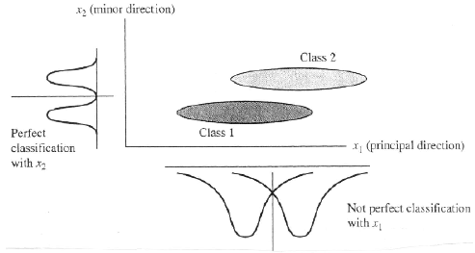
Limitations (cont’d)
PCA is not always an optimal dimensionality-reduction technique for classification purposes.

Slide 40
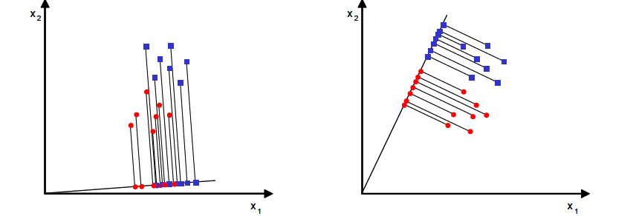
Linear Discriminant Analysis (LDA)
What is the goal of LDA?
Seeks to find directions along which the classes are best separated (i.e., increase discriminatory information).
It takes into consideration the scatter within-classes and between-classes.
Bad separability
Good separability

Slide 41
Case of C classes
Let us assume C classes
Let is assume each class contains M_{i} samples, i=1,2,..,C and that
Let μ_{i} is the mean of the i-th class, i=1,2,…,C
Within-class scatter matrix
Between-class scatter matrix
(i.e., μ is the mean of means)

Slide 42
Case of C classes (cont’d)
Suppose the desired projection transformation is:
Suppose the scatter matrices of the projected data y are:
LDA seeks projections that maximize the between-class scatter and minimize the within-class scatter:

Slide 43

Case of C classes (cont’d)
It can be shown that the columns of the matrix U are the eigenvectors (i.e., called Fisherfaces) corresponding to the largest eigenvalues of the following generalized eigen-problem:
Note: S_{b} has at most rank C-1; therefore, the max number of eigenvectors with non-zero eigenvalues is C-1 (i.e., max dimensionality of sub-space is C-1)

Slide 44
Example

Slide 45
Case of C classes (cont’d)
If S_{w} is non-singular, we can solve a conventional eigenvalue problem as follows:
In practice, S_{w} is singular due to the high dimensionality of the data (e.g., images) and the much smaller number of data (M << N )

Slide 46
Does S_{w}⁻¹ always exist? (cont’d)
To alleviate this problem, PCA could be applied first:
Apply PCA to reduce data dimensionality:
Apply LDA to find the most discriminative directions:

Slide 47
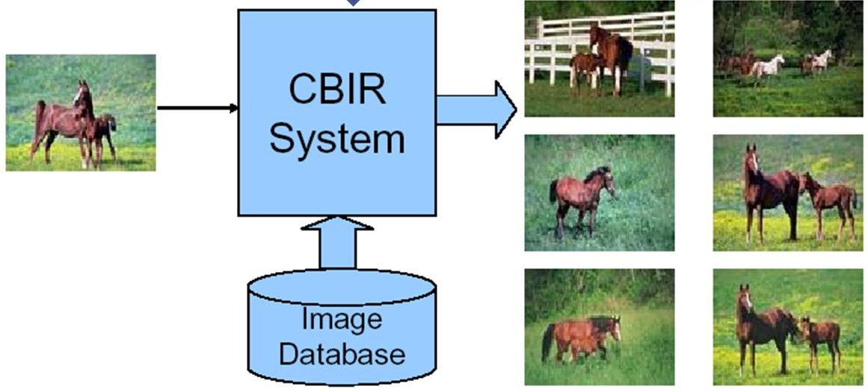
Case Study I
D. Swets, J. Weng, "Using Discriminant Eigenfeatures for Image Retrieval", IEEE Transactions on Pattern Analysis and Machine Intelligence, vol. 18, no. 8, pp. 831-836, 1996.
Content-based image retrieval:
Application: query-by-example content-based image retrieval
Question: how to select a good set of image features for content-based image retrieval?

Slide 48
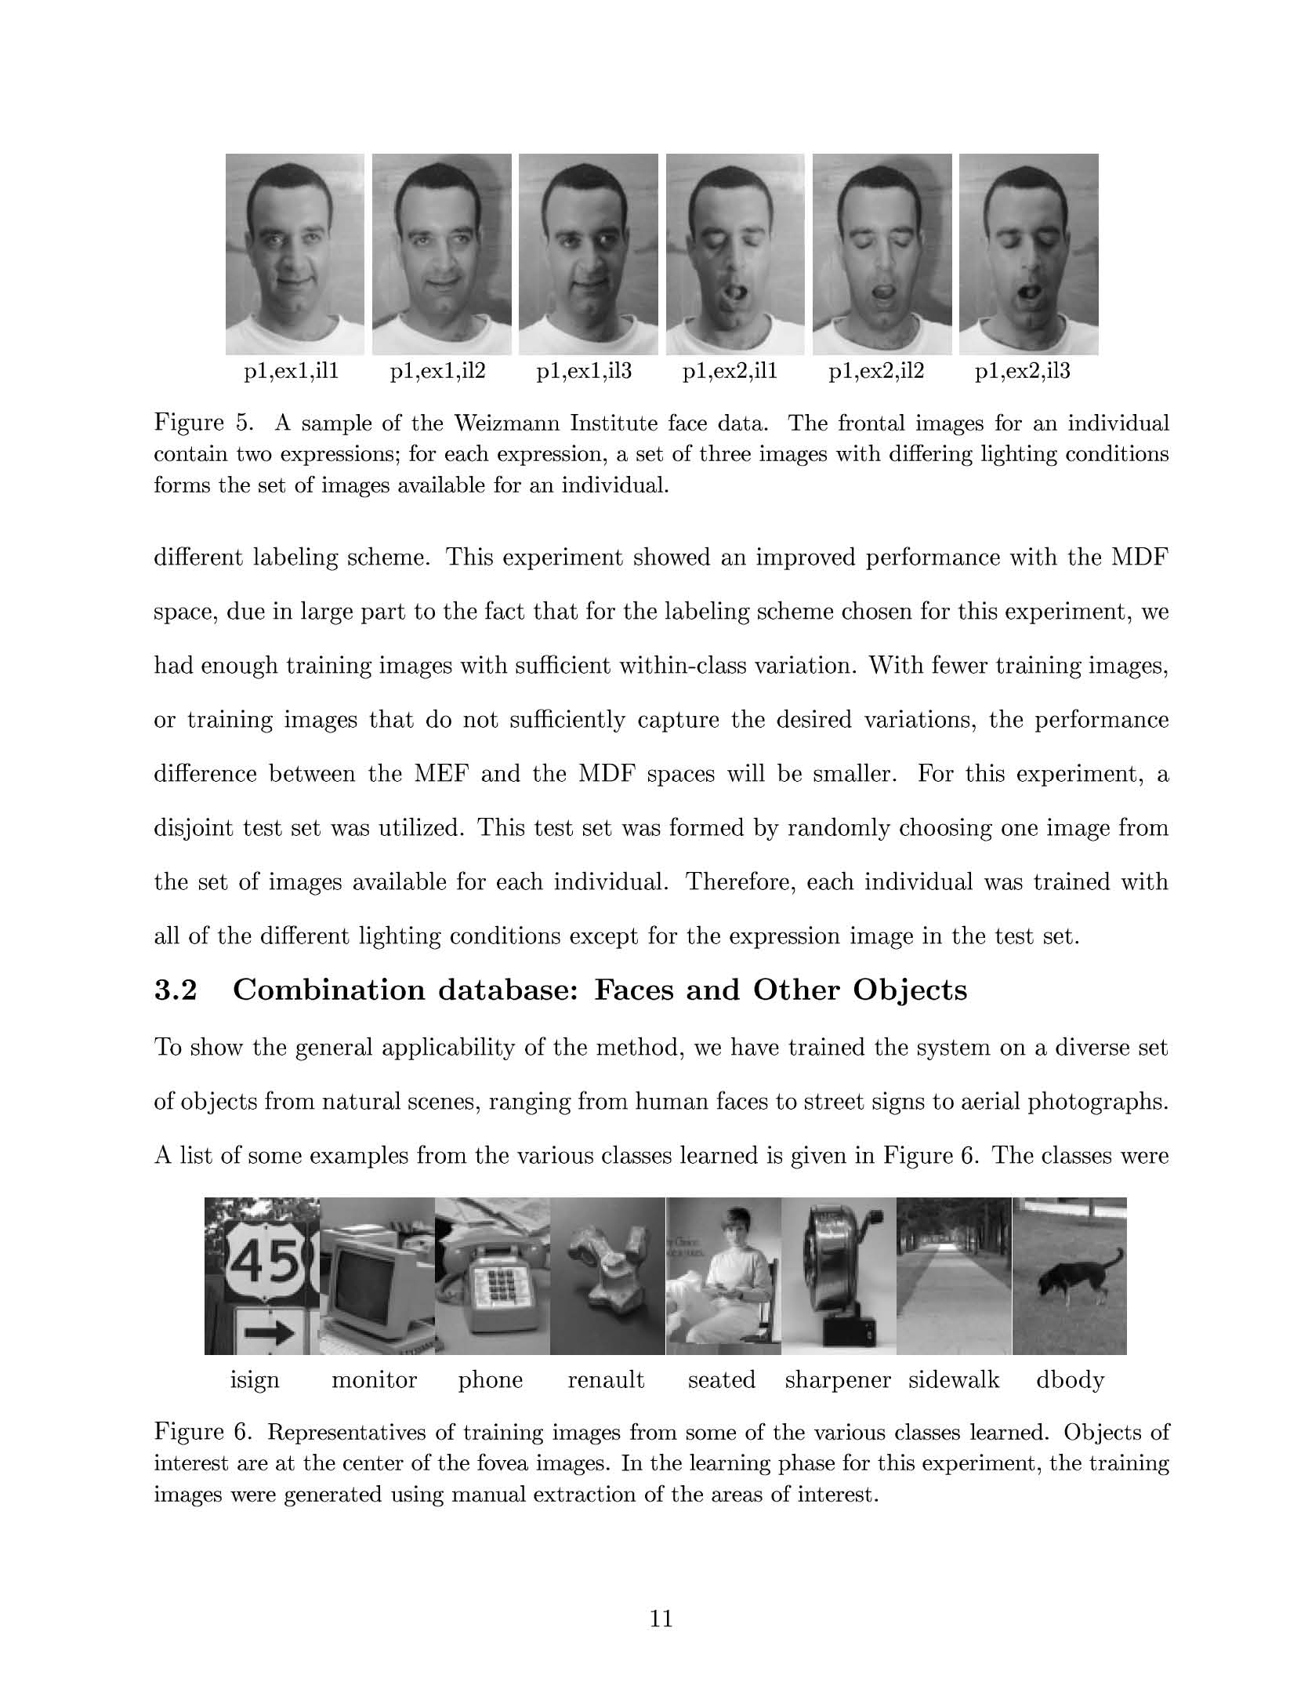
Case Study I (cont’d)
Assumptions
Well-framed images are required as input for training and query-by-example test probes.
Only a small variation in the size, position, and orientation of the objects in the images is allowed.

Slide 49
Case Study I (cont’d)
Terminology
Most Expressive Features (MEF): features obtained using PCA.
Most Discriminating Features (MDF): features obtained using LDA.
Numerical instabilities
Computing the eigenvalues/eigenvectors of S_{w}⁻¹S_{B}u_{k} = λ_{k}u_{k} could lead to unstable computations since S_{w}⁻¹S_{B} is not always symmetric.
Look in the paper for more details about how to deal with this issue.

Slide 50
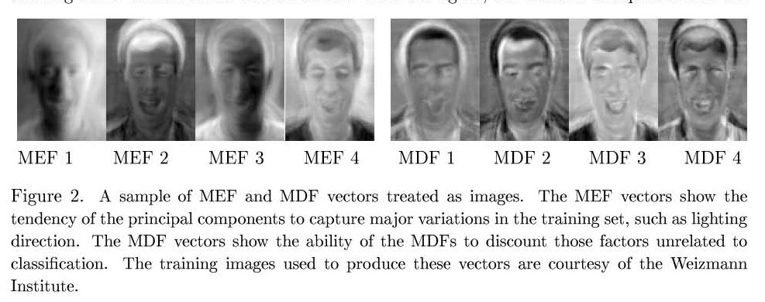
Case Study I (cont’d)
Comparing MEF with MDF:
MEF vectors show the tendency of PCA to capture major variations in the training set such as lighting direction.
MDF vectors discount those factors unrelated to classification.

Slide 51
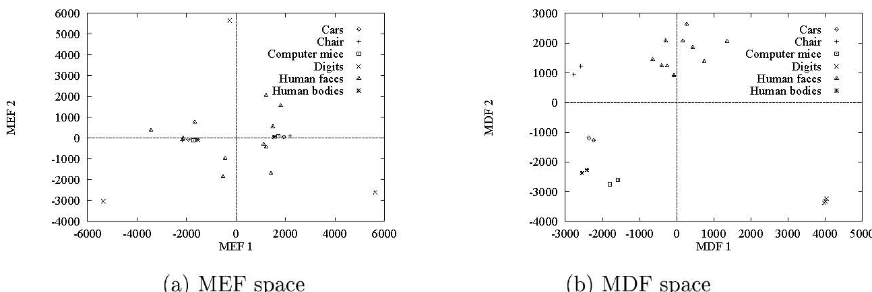
Case Study I (cont’d)
Clustering effect

Slide 52
Case Study I (cont’d)
Methodology
Represent each training image in terms of MEFs/MDFs.
Represent a query image in terms of MEFs/MDFs.
Find the k closest neighbors (e.g., using Euclidean distance).

Slide 53
Case Study I (cont’d)
Experiments and results
Face images
A set of face images was used with 2 expressions, 3 lighting conditions.
Testing was performed using a disjoint set of images.

Slide 54
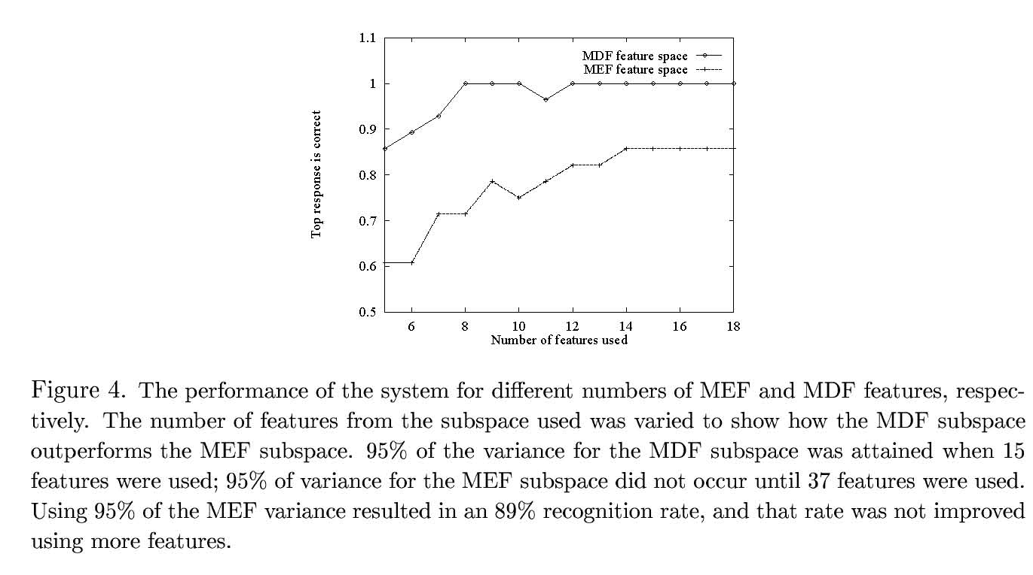
Case Study I (cont’d)
Top match

Slide 55
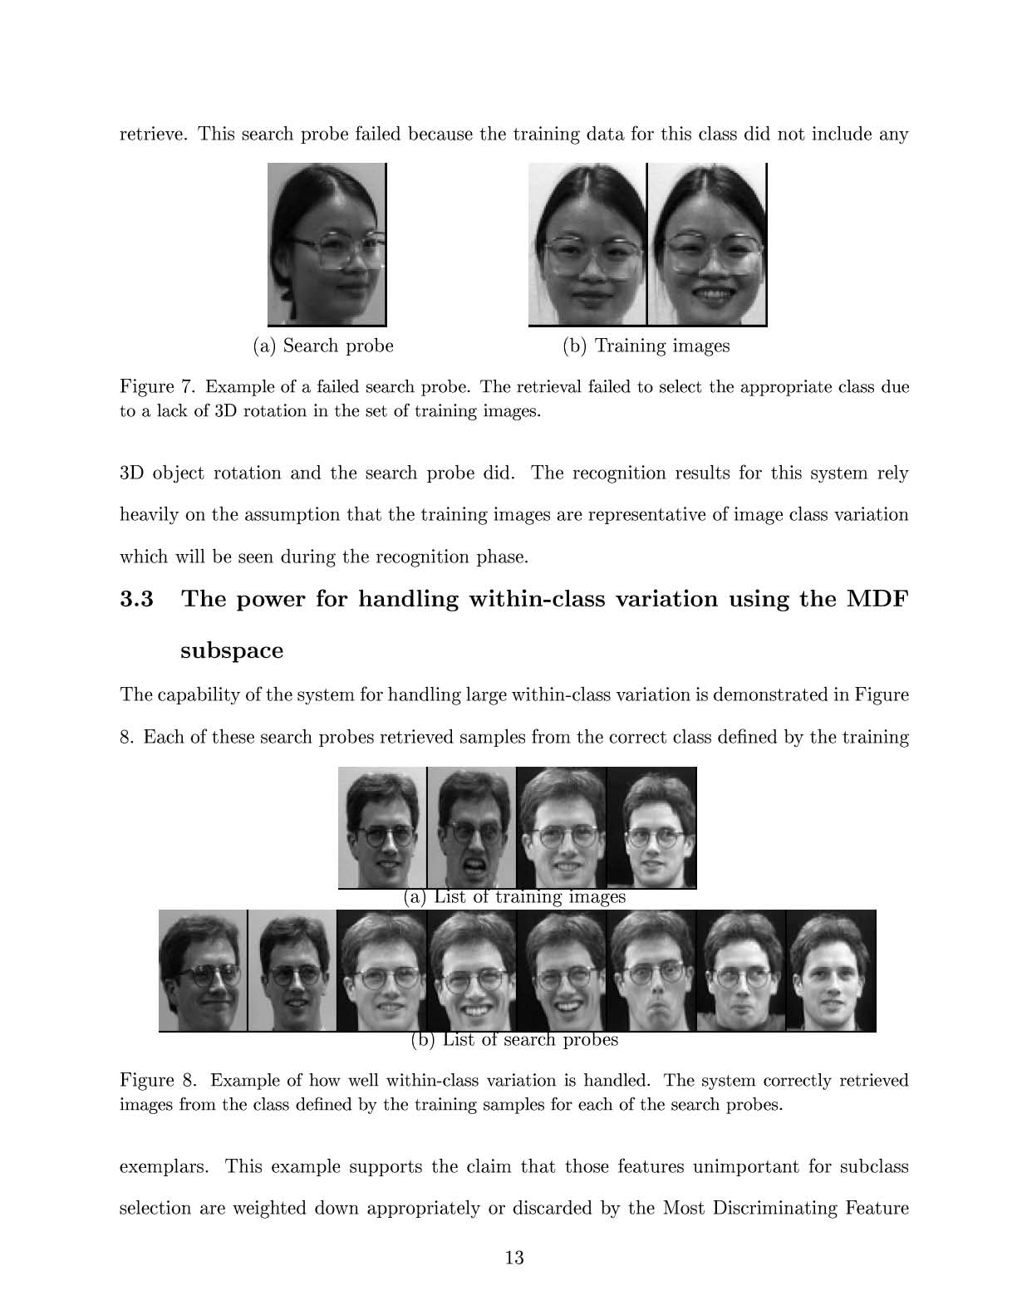
Case Study I (cont’d)
Examples of correct search probes

Slide 56
Case Study I (cont’d)
Example of a failed search probe

Slide 57
Case Study II
A. Martinez, A. Kak, "PCA versus LDA", IEEE Transactions on Pattern Analysis and Machine Intelligence, vol. 23, no. 2, pp. 228-233, 2001.
Is LDA always better than PCA?
There has been a tendency in the computer vision community to prefer LDA over PCA.
This is mainly because LDA deals directly with discrimination between classes while PCA does not pay attention to the underlying class structure.

Slide 58
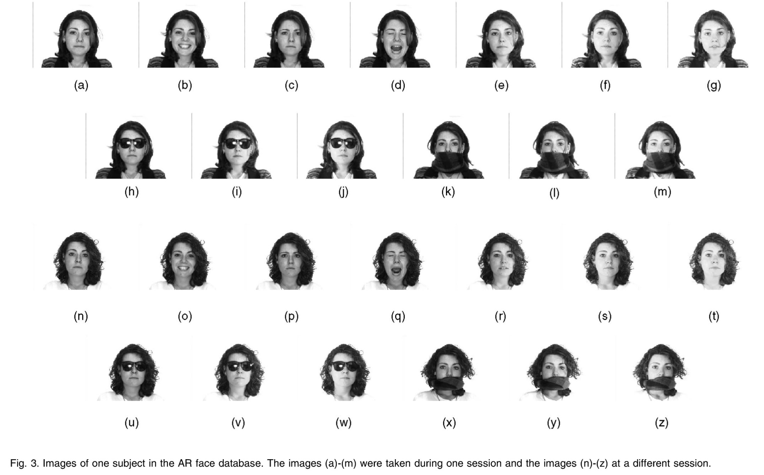
Case Study II (cont’d)
AR database

Slide 59

Case Study II (cont’d)
LDA is not always better when the training set is small

Slide 60
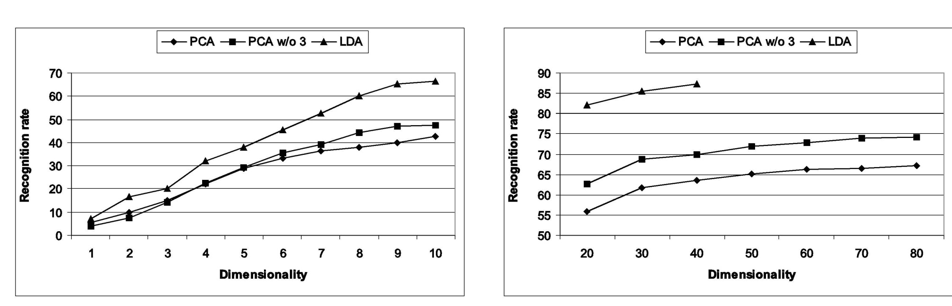
Case Study II (cont’d)
LDA outperforms PCA when the training set is large

